Slide 1



Ministry/Organization Name – Government of Goa Team Name-
Horizon
Problem Statement
Title - Alumni Tracking System
Team Leader Name - Priyanshu Shrivastava
Problem Statement Description-
The Directorate of Higher Education has 7 Government Colleges and 26 aided colleges under it. Altogether, more than 10000 students that pass out from them every year either choose to opt for further studies, work or have their own startups. Currently, there is no mechanism for the colleges and the Directorate to keep a track of the students passing out. Hence, the problem is to develop a web based application for colleges and the Directorate to keep a track of the Alumni. The said application should have the following features:- (a) allow the Alumni members to register themselves (b) allow colleges to verify and authenticate their registered alumni (c) provision for alumni members to update their details (d) allow the colleges to search details based on criteria such as year, subject, etc. (e) allow the Directorate to search details based on criteria such as colleges, year, subject, etc. (f) send messages and emails to alumni members (g) group chats, create events, publish notices on the portal (h) Security features with login for every user

Slide 2



Solution
The solution will include a package of website and an android app
for keeping track of alumni and all the pass out students that will
Help both college authorities and directorate to keep record of
their alumni.
The major benefits undertaken are-
Userfriendly Interface
Both website and application will be made such that it fall easy to all group of pass outs.
Regular Updates
Regular connection to the registered alumni will be established so that any upgradation or decline in their career will be taken into consideration.
Easy Bifurcation
The application will allow both college and directorate to search details of registered alumni based on criteria such as college, year,subject etc.
Authorized Entry Only
The user’s acount will be made as soon as a person become legal applicant of an institute and login to his/her account can be accessed
only through valid student Id set by directorate itself.

Slide 3

Technology Stack
HTML /CSS /Bootstrap
These are basic languages used to make interface of websites.
FXML
Basic frontend language
for android app development.
Firebase
It is a common platform provided
by Google for websites and app
development.
Kotlin
It is the lightest and fastest
android app backend
language for android apps.
JavaScript
This is the basic backend
language for a website .
jQuery / Node.js
These are JavaScript frameworks
which are used to make
websites more interactive

Slide 4
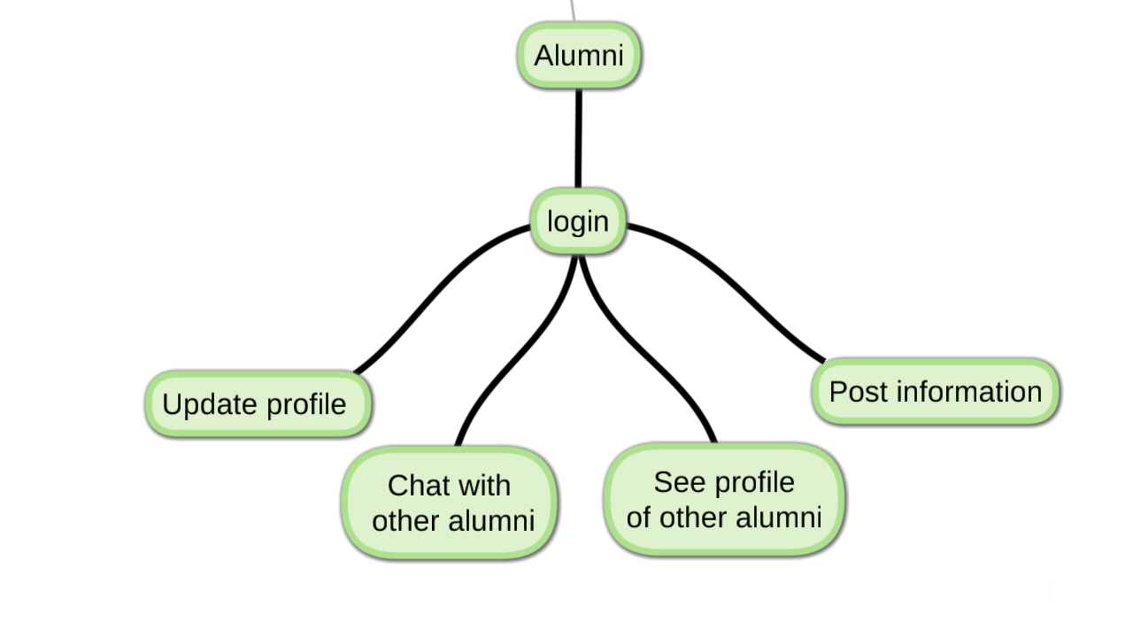

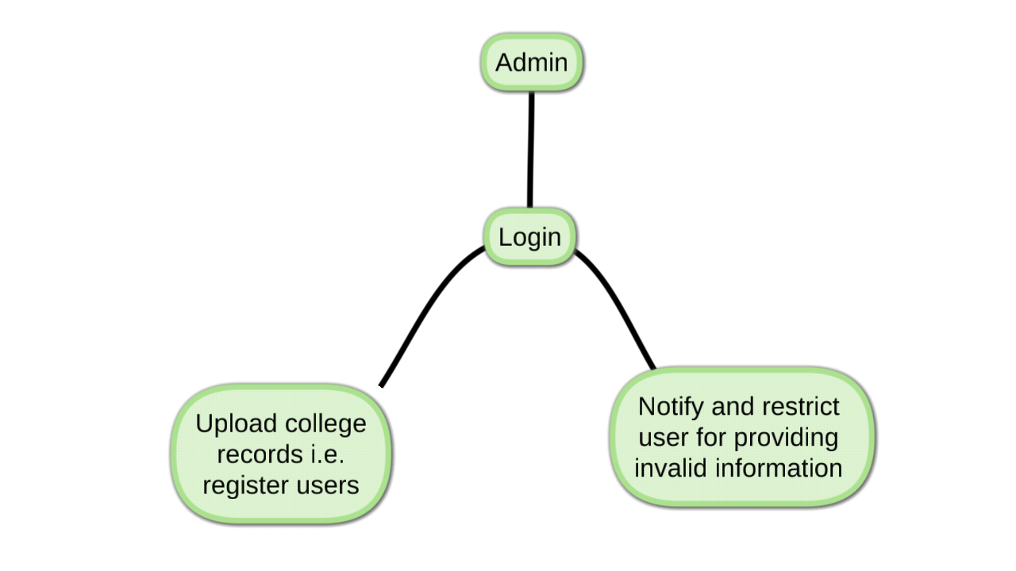
Use Cases

Slide 5

Dependencies
Dependency on User
The website created will be dependent
on alumni for upgradation and validity.
Reality Check
Completely dependent on user whether information provided is valid or not.
Regular Upgradation
Frequent upgradation required to keep track of career record of the alumni.

